Slide 1

SEO SITE Audit
Sahar Andaleeb
Week # 10
SITE AUDIT
By: Sahar Andaleeb

Slide 2
Seo audit
“An SEO audit is the process of evaluating how well your website is optimized for search engines.”
It identifies errors that can prevent your site from ranking well and opportunities that can help you rank better.
An SEO site audit can be performed at two key stages:
Before Launching the website &
After launching the website
Week # 10
SITE AUDIT
By: Sahar Andaleeb

Slide 3
Seo site audit befor vs after launch
An SEO audit serves distinct purposes depending on whether it's conducted before or after launching a website.
When performed before launch, an SEO audit is crucial for early issue detection, allowing you to identify and fix problems before they impact your site's debut.
In contrast, conducting an SEO audit after launching a website provides real-world validation of your site's performance.
It reveals how users and search engines interact with the site in a live environment, offering insights into user behavior that might highlight navigation or content issues.
.
Week # 10
SITE AUDIT
By: Sahar Andaleeb

Slide 4
Goal of seo audit
The goal of an SEO site audit is to uncover opportunities for optimization that can improve the website's visibility, traffic, and ultimately, conversions, leading to a higher return on investment for the client.
Week # 10
SITE AUDIT
By: Sahar Andaleeb

Slide 5
Manual seo audit vs seo audit using specialized tools
“ Manual SEO Audit is conducted by experts, involving manually reviewing your website.”
They offer Customized analysis after thoroughly understanding your website’s unique needs and provides tailored recommendations.
They can identify specific issues that automated tools might miss
Gap in content
Strategic alignment with business goals
Ignored user intent
Requires more time and effort to complete.
Week # 10
SITE AUDIT
By: Sahar Andaleeb

Slide 6
… cont.
“SEO Audit with Specialized Tools is an automated process that utilizes software to scan your website for common SEO issues based on predefined rules.”
Quick and efficient: Can evaluate multiple SEO metrics simultaneously and generate reports quickly.
Quantitative Data: Provides detailed reports with metrics like page speed, backlink count, and keyword rankings.
Generates graphs and charts for easy interpretation.
Cost-Effective: Often more affordable than manual audits.
Limited Context: May not capture qualitative elements or unique issues.
Week # 10
SITE AUDIT
By: Sahar Andaleeb

Slide 7
… cont.
How to decide whether to perform a manual site audit or a seo audit using specialized tools”
While automated tools can give you a quick health check of your website, a manual audit provides a more in-depth and personalized analysis. A combination of both approaches often yields the best results.
Week # 10
SITE AUDIT
By: Sahar Andaleeb

Slide 8
What to Do Before Starting Your SEO Audit
Before launching an SEO audit, make sure to:
Outline your goals:
Determine the metrics to measure
→ KPIs Key Performance Indicators
Week # 10
SITE AUDIT
By: Sahar Andaleeb

Slide 9
SEO Audit checklist Before Launching a Site
Keyword Research and Strategy:
Identify relevant keywords and phrases for your industry.
Determine keyword competition and search volume.
Site Architecture and Structure:
Organize content logically for user experience.
Ensure a clear and effective navigation structure.
Content Quality and Relevance:
Develop high-quality, original content.
Align content with user intent and SEO best practices.
Week # 10
SITE AUDIT
By: Sahar Andaleeb

Slide 10
… cont.
Technical SEO:
Check for crawlability and indexability by search engines.
Ensure proper URL structure, sitemap, and robots.txt.
Optimize site speed and mobile-friendliness.
On-Page Optimization:
Optimize meta titles, descriptions, and header tags.
Implement proper internal linking and keyword usage.
Backlink Strategy:
Plan for initial backlink building and partnerships.
Ensure the avoidance of spammy or low-quality links
Week # 10
SITE AUDIT
By: Sahar Andaleeb

Slide 11
SEO Audit checklist after Launching a Site
Performance Monitoring:
Track site speed, user behavior, and overall traffic.
Analyze Google Analytics and Search Console data.
Reassess Indexing and Visibility:
Confirm proper indexation by search engines.
Identify any crawl errors or manual actions.
On-Page Review:
Reassess meta titles, descriptions, and header tags.
Check for broken links and update internal linking as needed.
Content Analysis:
Review content for relevance and freshness.
Identify content gaps and opportunities for updates or new content.
Week # 10
SITE AUDIT
By: Sahar Andaleeb

Slide 12
…cont.
Backlink Analysis:
Audit current backlinks for quality and relevance.
Disavow any toxic or harmful backlinks.
Technical Review:
Re-evaluate site speed and mobile responsiveness.
Check schema markup and structured data implementation.
Continuous Improvement:
Monitor competitor strategies and industry trends.
Adapt SEO strategies based on analytics insights and SEO best practices.
Week # 10
SITE AUDIT
By: Sahar Andaleeb

Slide 13
end goal of an SEO audit checklist?
The primary goal is to identify and address issues that could negatively impact your site’s organic visibility.
The checklist serves as a roadmap to ensure that all necessary steps are taken to maintain or improve SEO
Week # 10
SITE AUDIT
By: Sahar Andaleeb

Slide 14
Seo site audit process
0. Initial Audit for setting the benchmarks
Use tools like SEOquake (free chrome plugin Keyword Research)
Sitebulb (revolutionary website crawler for better SEO audits.)
Keyword Research:
Know business intent/product to specify focused keywords.
Ask questions from clients;
What would you search if you want to buy from your brand
"What business problem are you addressing with your solution? & what is the solution?
Carry out a comprehensive keyword research
Narrow it down..
Create keyword clusters
Assign to relevant pages
Week # 10
SITE AUDIT
By: Sahar Andaleeb

Slide 15
Seo site audit process .. Cont.
OnPage Optimization with keywords:
Domain Name → EMD (Exact Match Domain)
URL, KW to Target, Pg Title, Meta Discription
Accessibility & crawl check:
(Technical Optimization)
Both for crawlers & humans(audience)
Accessibility ensures that your website is usable by all users, including those with disabilities, and is also friendly to search engine crawlers.
… cont. P.T.O
Week # 10
SITE AUDIT
By: Sahar Andaleeb
Notes:
Start with money pages..

Slide 16
…cont.
3. Accessibility check for crawlers… cont.
Crawlability:
Ensure that search engine crawlers can access and navigate your website without barriers.
Check for robots.txt issues, blocked pages, or JavaScript-heavy content that might hinder crawling.
Indexability:
Verify that your content is indexable by search engines, with no disallowed sections in the robots.txt file or meta tags that prevent indexing.
Use free SEO tool such as “ScreamingFrog”.
Screaming Frog crawls your site the same way Google would. And it lets you know about pages that it can’t access.
Week # 10
SITE AUDIT
By: Sahar Andaleeb

Slide 17
..cont.
Sitemaps:
Submit a sitemap to search engines to guide crawlers through your site's structure, ensuring they find all important pages.
Canonicalization:
Use canonical tags to indicate preferred URLs and avoid duplicate content issues.
Week # 10
SITE AUDIT
By: Sahar Andaleeb

Slide 18
…cont.
3. Accessibility check for Humans… cont.
Clear Navigation and Readability:
Ensure clear and consistent navigation with readable text, proper color contrast, and alternative text for images.
Headings and Structure
Ensure proper use of HTML headings (H1, H2, H3, etc.) to structure content logically.
Use descriptive and unique headings.
Assistive Technologies:
Design your site to work with screen readers, keyboard navigation, and other assistive technologies.
Week # 10
SITE AUDIT
By: Sahar Andaleeb

Slide 19
…cont.
3. crawl check…cont.
Crawl check involves verifying that search engine crawlers can successfully navigate and understand your website.
Crawl Errors:
Identify and fix crawl errors, such as 404s, server errors, or redirects.
Use Google Search Console to check crawl stats and identify problematic areas.
Internal Linking:
Create a logical internal linking structure to guide crawlers through your site's content hierarchy.
Avoid orphaned pages with no internal links pointing to them.
Week # 10
SITE AUDIT
By: Sahar Andaleeb

Slide 20
Seo site audit process .. Cont.
4. Mobile comes first.
Check To See If Your Site Is Mobile-Friendly
Mobile SEO is more important than ever.
Responsive Design
Ensure the website adapts to different screen sizes and orientations.
Page Load Speed
Optimize for fast loading on mobile devices. Use tools like Google PageSpeed.
Readable Fonts
Use legible font sizes and ensure text is readable without zooming.
Tap-Friendly Interactions
Ensure buttons and links are large enough for easy tapping with fingers.
Week # 10
SITE AUDIT
By: Sahar Andaleeb

Slide 21
Seo site audit process …cont.
4. UX/UI Check
UX/UI check ensures a positive user experience through intuitive design, clear interfaces, and seamless interactions.
For Crawlers:
Structured Data:
Implement structured data (schema markup) to help crawlers understand your site's content and context.
Page Structure:
Ensure a logical structure with clear headings (H1, H2, etc.) to guide crawlers through the content.
Mobile-Friendliness:
Check mobile responsiveness to ensure crawlers view your site as mobile-friendly, a key SEO ranking factor.
Week # 10
SITE AUDIT
By: Sahar Andaleeb

Slide 22
Seo site audit process …cont.
4. UX/UI Check …cont.
For Humans:
User Interface (UI):
Design a clean, intuitive interface that facilitates easy navigation and content discovery.
User Experience (UX):
Focus on user-centered design, ensuring that the site is engaging, functional, and easy to use.
Mobile Experience:
Offering a seamless experience across different viewports.
Interactivity and Engagement:
Include interactive elements that enhance user engagement without overwhelming or distracting from the main content.
Week # 10
SITE AUDIT
By: Sahar Andaleeb

Slide 23
Seo site audit process …cont.
5. Set up Google Analytics and Search Console:
If you don’t know what’s happening with your site, you can’t fix it. And if you don’t know what’s working, you can’t make sure to do it on every page.
Understanding organic traffic and where your links are coming from is critical.
Week # 10
SITE AUDIT
By: Sahar Andaleeb

Slide 24
Seo site audit process…cont.
6. Optimize Content With Keywords
“Content is king”
Conduct competitor research.
Analyze keyword opportunities and look for gaps
these are topics your competitors are covering that you aren’t.
Create content targeting those keywords
7. Speed Check:
Check Loading Times
Run a performance analysis with Google PageSpeed Insights.
Get your page speed score and improve highlighted errors.
Week # 10
SITE AUDIT
By: Sahar Andaleeb

Slide 25
Seo site audit process…cont.
Link building strategy:
To set a strong foundation for link building, consider these key aspects:
Competitor Analysis: Examine your competitors' backlink profiles to understand where they get their links.
Content Strategy: Develop high-quality content like blogs, infographics, videos, or research reports that naturally attract links.
Outreach Opportunities: Identify relevant industry influencers, bloggers, or websites to establish collaborations and gain backlinks.
Technical SEO: Make sure your website has a proper URL structure, effective internal linking, and is easily crawlable to support link building.
Avoid Black Hat Techniques: Steer clear of link schemes, buying links, or manipulative tactics to avoid search engine penalties.
Week # 10
SITE AUDIT
By: Sahar Andaleeb

Slide 26
Seo site audit process…cont.
→ LAUNCH YOUR WEBSITE:
Check KPIs Key Performance Indicators:
(Determine what metrics are most important for the website's goals. → time on site, bounce rate, visits.)
After a few days, it's time to check how your website is doing. Look into things like bounce rate and time on site to see which pages perform great, and which need improvements.
Performance Monitoring:
Track site speed, user behavior, and overall traffic.
Analyze Google Analytics and Search Console data.
Week # 10
SITE AUDIT
By: Sahar Andaleeb

Slide 27
Seo site audit process…cont.
Reassess Indexing and Visibility:
Confirm proper indexation by search engines.
Identify any crawl errors or manual actions.
On-Page Review:
Reassess meta titles, descriptions, and header tags.
Check for broken links and update internal linking as needed.
Content Analysis:
Review content for relevance and freshness.
Identify content gaps and opportunities for updates or new content.
Week # 10
SITE AUDIT
By: Sahar Andaleeb

Slide 28
Seo site audit process…cont.
Spread the word
Once your new website is running smoothly, it's time to generate some buzz. Post the news on social media, your blog and send out a newsletter. Reach out to media outlets and bloggers within your market and share the news. A website launch is a great way to get some extra attention for your company.
Keep improving
If googlebot visit you, before you have updated any content on your site, it will try to visit you after a longer interval next time.
& vise versa
Regular content updation with new & updated keywords → diversifies your audience, you out rank your competition by taking away his breathing room.
Week # 10
SITE AUDIT
By: Sahar Andaleeb

Slide 29
Seo audit report
Identify key performance indicators (KPIs): Determine what metrics are most important for the website's goals.
Benchmark current performance: Establish a baseline for comparison before making changes.
Prioritize issues: Sort findings by their potential impact on performance and urgency.
Implement changes: Make the recommended improvements based on the audit.
Monitor progress: Track the KPIs over time to measure the effectiveness of the changes.
Report to stakeholders: Communicate the findings, actions taken, and results to clients or team members in a clear format
Week # 10
SITE AUDIT
By: Sahar Andaleeb

Slide 30
Creating seo audit report
Use tools like SiteBulb, SEOQuake
To find out what templates are commonly used for SEO reports, visit the following link: https://youtu.be/YfRe1STZNr4?si=_BU1uxiEYF3_xEvJ
Carry out an SEO site audit for your project website & attach it in out project file.
Week # 10
SITE AUDIT
By: Sahar Andaleeb

Slide 31
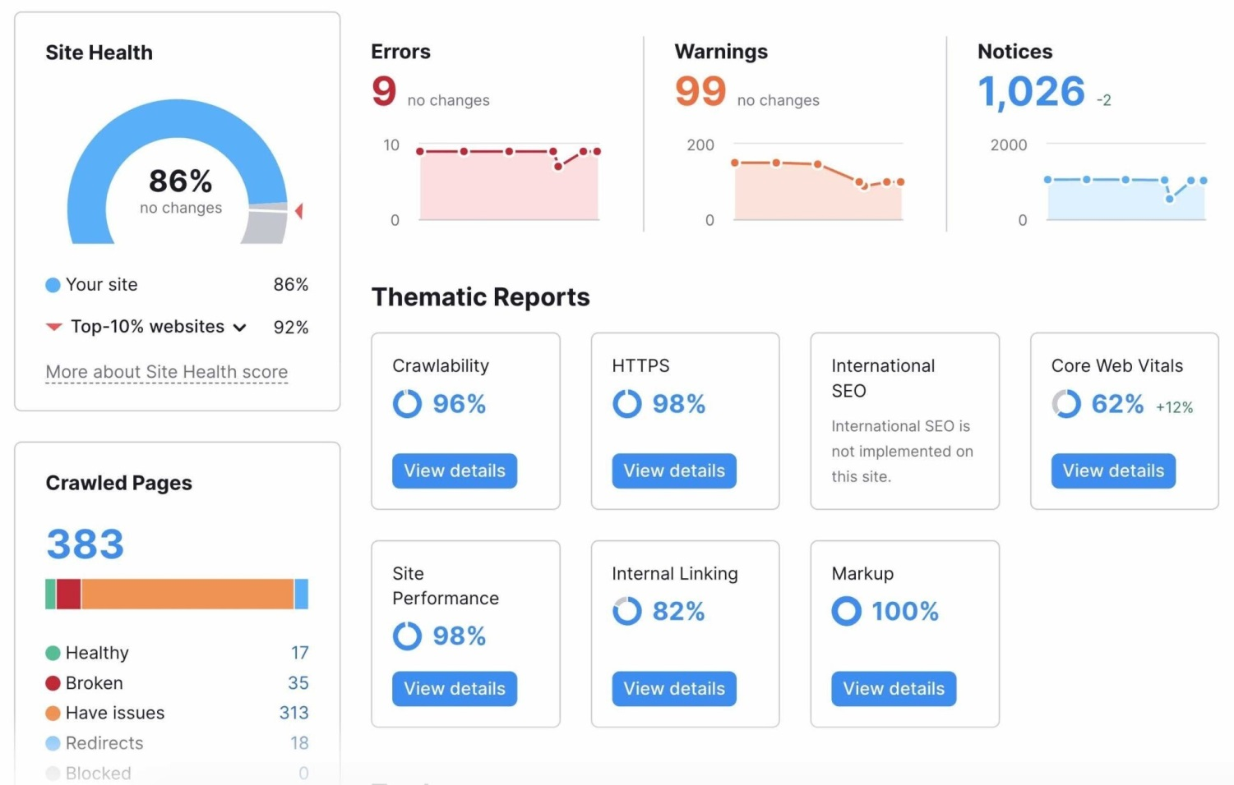
SsEO auditing tool
You'll need an SEO auditing tool like Semrush's Site Audit.
Create a project and set up the audit.
Week # 10
SITE AUDIT
By: Sahar Andaleeb

Slide 32
Exact Match Domain
EMD, or Exact Match Domain, refers to a domain name that exactly matches a specific keyword or phrase. This concept is often used in SEO (Search Engine Optimization) to create domain names that align with common search terms or queries, with the goal of improving search engine visibility and rankings.
For example, if your business specializes in selling pet food, an EMD might be something like "PetFoodStore.com" or "BuyPetFood.com." The theory behind EMDs is that by incorporating a highly searched keyword directly into the domain name, a website might gain a boost in search engine results.
However, Google's algorithm
Week # 10
SITE AUDIT
By: Sahar Andaleeb

